Slide 1
CSC 2224: Parallel Computer Architecture and Programming Main Memory Fundamentals
Prof. Gennady Pekhimenko
University of Toronto
Fall 2019
The content of this lecture is adapted from the slides of
Vivek Seshadri, Donghyuk Lee, Yoongu Kim,
and lectures of Onur Mutlu @ ETH and CMU

Slide 2
Review #4
RowClone: Fast and Energy-Efficient In-DRAM Bulk Data Copy and Initialization Vivek Seshadri et al., MICRO 2013

Slide 3
Why Is Memory So Important? (Especially Today)

Slide 4
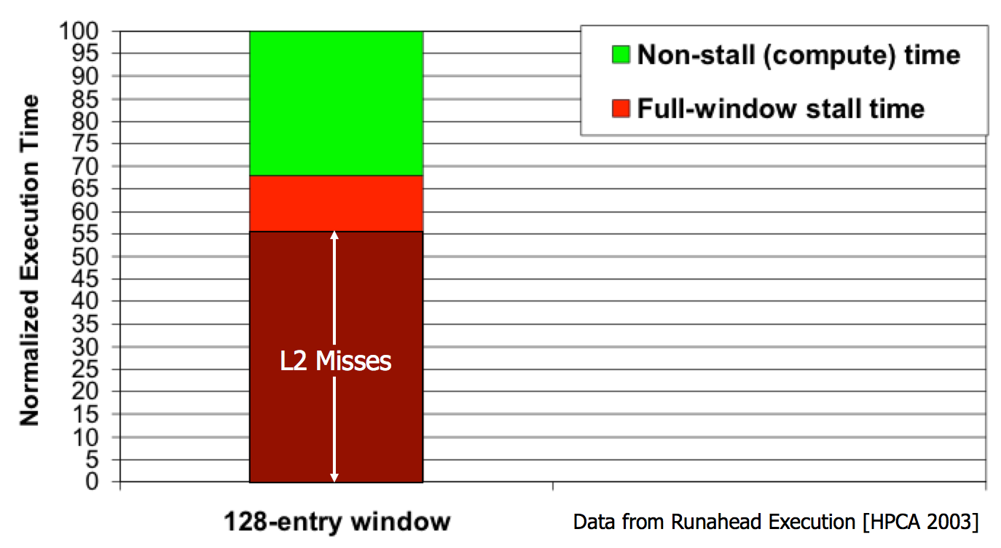
The Performance Perspective
“It’s the Memory, Stupid!” (Richard Sites, MPR, 1996)
Mutlu+, “Runahead Execution: An Alternative to Very Large Instruction Windows for Out-of-Order Processors,” HPCA 2003.

Slide 5
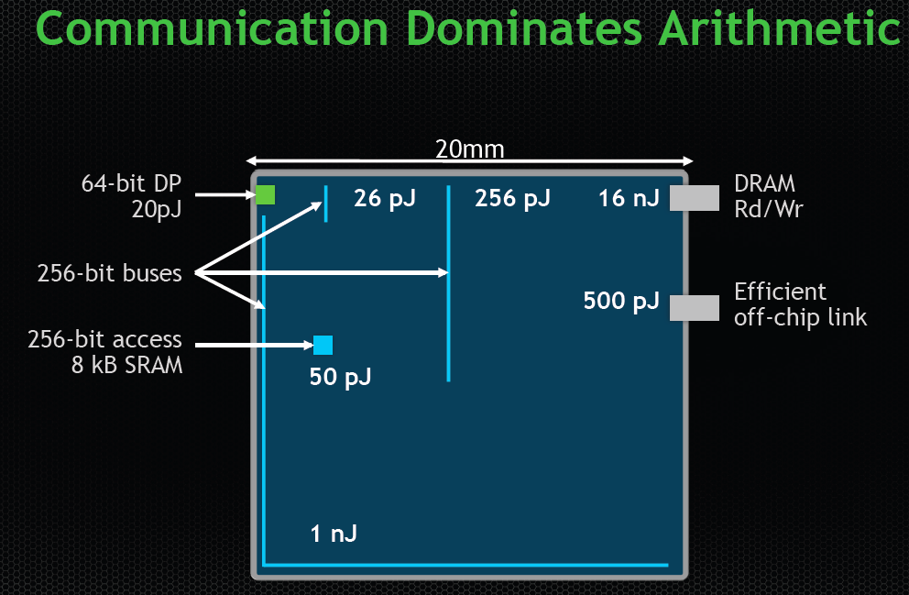
The Energy Perspective
Dally, HiPEAC 2015

Slide 6
The Energy Perspective
Dally, HiPEAC 2015
A memory access consumes ~1000X
the energy of a complex addition

Slide 7
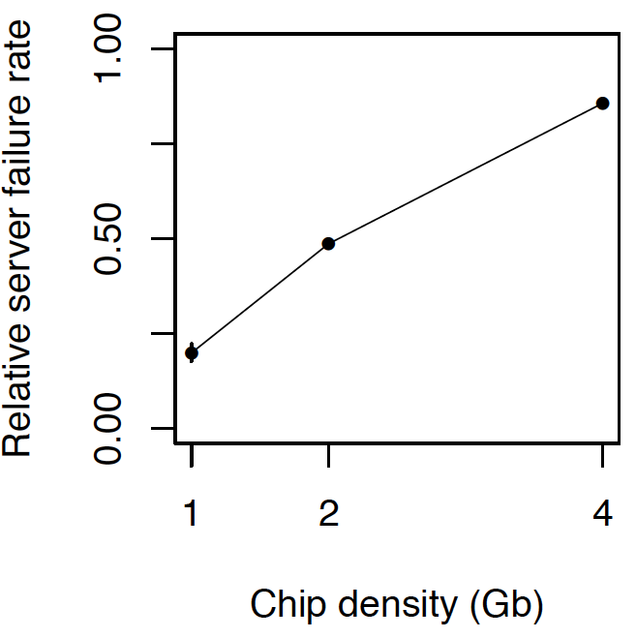
The Reliability Perspective
Data from all of Facebook’s servers worldwide
Meza+, “Revisiting Memory Errors in Large-Scale Production Data Centers,” DSN’15.
Intuition: quadratic increase in capacity

Slide 8
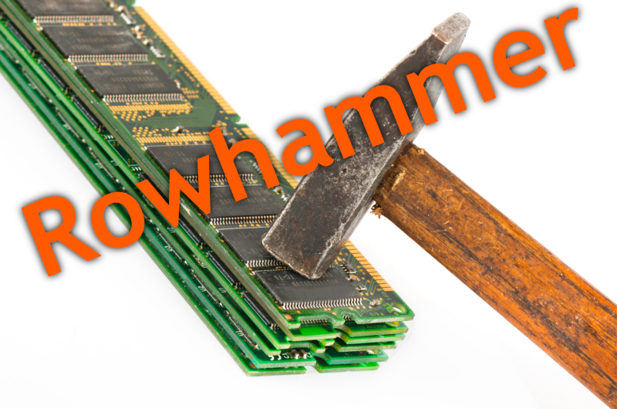
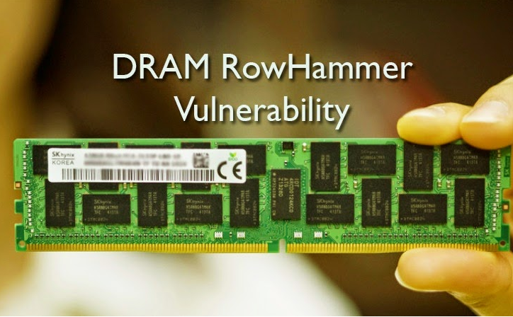
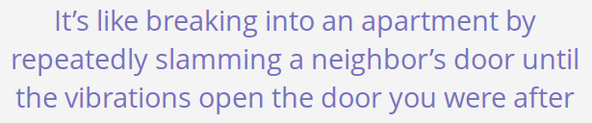
The Security Perspective
Notes:
Picture from the article:
http://thehackernews.com/2015/03/dram-rowhammer-vulnerability.html

Slide 9
Why Is DRAM So Slow?

Slide 10


Motivation (by Vivek Seshadri)
Conversation with a friend from Stanford
Why is DRAM so slow?!
Really?
50 nanoseconds to serve one request? Is that a fundamental limit to DRAM’s access latency?
Him
Vivek

Slide 11
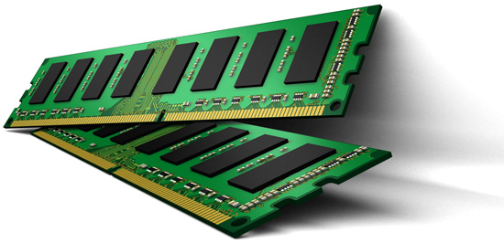
Understanding DRAM
What is in here?
DRAM
Problems related to today’s DRAM design
Solutions proposed by our research

Slide 12
Outline
What is DRAM?
DRAM Internal Organization
Problems and Solutions
Latency (Tiered-Latency DRAM, HPCA 2013, Adaptive-Latency DRAM, HPCA 2015)
Parallelism (Subarray-level Parallelism, ISCA 2012)

Slide 13
What is DRAM?
DRAM – Dynamic Random Access Memory
Array of Values
READ address
3455434
43543
WRITE address, value
98734
Accessing any location takes the same amount of time
0
847
42
Data needs to be constantly refreshed
873909
1729
Notes:
DRAM stands for Dynamic Random Access Memory.
Memory, as many of may know, is a device that can store information and allow the information to be retrieved at a later point in time. The simplest abstraction for memory is an array of fixed-size values. We can read from a location by specifying its address or write to a location by providing its address and the value to be written.
A random access memory is one in which accessing any location takes the same amount of time.
The dynamic part of DRAM refers to the fact that DRAM loses data when left alone.

Slide 14
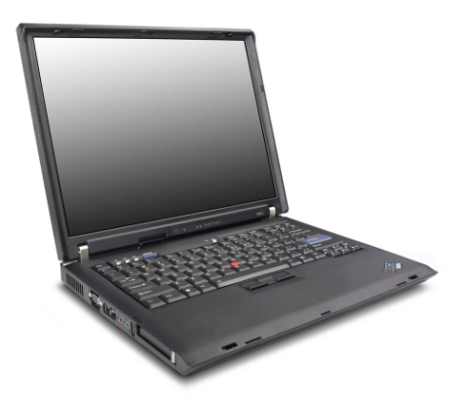
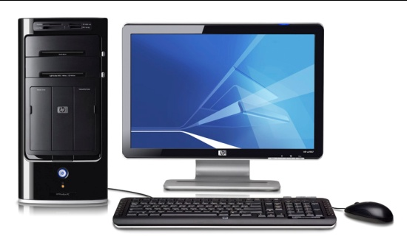

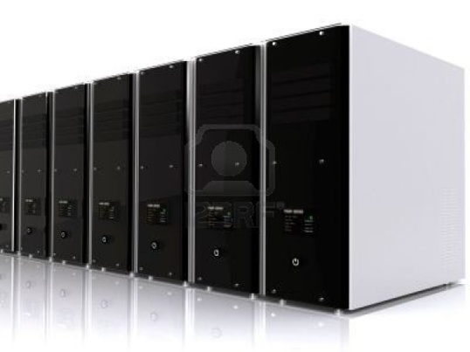
DRAM in Today’s Systems
Why DRAM? Why not some other memory?
Notes:
DRAM memory is an integral part of most computing systems today. Desktops, laptops, mobile phones, large servers; all of them have DRAM based memory.
In fact, if you ever wondered why your laptops have a separate sleep mode and hibernate mode, the dynamic part of DRAM is one of the primary reasons. In the sleep mode, the DRAM in your laptop is still powered on and kept in a state where it does not lose its data. In the hibernate mode, the data in DRAM is written to the hard disk and the system is completely shutdown.
Why DRAM? Why not some other memory?

Slide 15
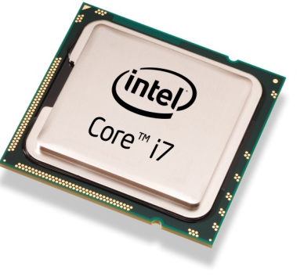
Von Neumann Model
Processor
Memory
Program
Data
4 instruction accesses +
3 data accesses
T1 = Read Data[1]
T1 = Read Data[1]
3
T2 = Read Data[2]
4
4
T3 = T1 + T2
8
Write Data[3], T3
2
Memory performance is important

Slide 16
Factors that Affect Choice of Memory
Speed
Should be reasonably fast compared to processor
Capacity
Should be large enough to fit programs and data
Cost
Should be cheap
Notes:
There are three factors that affect the choice of memory in a system.
Speed, Capacity and Cost. Blah..
In fact, as we will see in this talk, cost is one of the primary factors that drives decisions taken by the industry.

Slide 17
Why DRAM?
Flip-flops
Higher Cost
Favorable point in the trade-off spectrum
SRAM
Cost
DRAM
Higher access latency
Disk
Flash
Access Latency
Notes:
In contrast, DRAM is at a favorable point in this trade-off spectrum between cost and latency. And it is going to remain so for the foreseeable future.

Slide 18
Is DRAM Fast Enough?
Processor
Commodity DRAM
Core
Core
Core
Core
Latency
3 GHz, 2 Instructions / cycle
50ns
300 Instructions
Parallelism
Request
300 Instructions
Request
300 Instructions
Request
300 Instructions
Request
Independent programs
Served in parallel?
Notes:
Is DRAM fast enough? Let us try to understand this using today’s processor and DRAM technology. The DRAM we can buy today, which I will refer to as commodity DRAM, takes 50ns to serve a request. A modern processor running at 3Ghz and executing 2 instructions every cycle can run up to 300 instructions in the same duration. To make matters worse, modern processors have multiple cores which can independently execute different programs. If each of these programs independently generate memory requests, the question is whether DRAM can serve the requests in parallel? If the independent requests are served serially, then the cores will have to wait for much longer before doing any useful work. So, there are two problems related to DRAM that we need to address: Latency and Parallelism.

Slide 19
Outline
What is DRAM?
DRAM Internal Organization
Problems and Solutions
Latency (Tiered-Latency DRAM, HPCA 2013, Adaptive-Latency DRAM, HPCA 2015)
Parallelism (Subarray-level Parallelism, ISCA 2012)

Slide 20
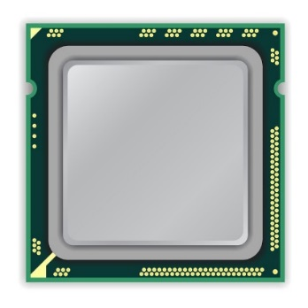
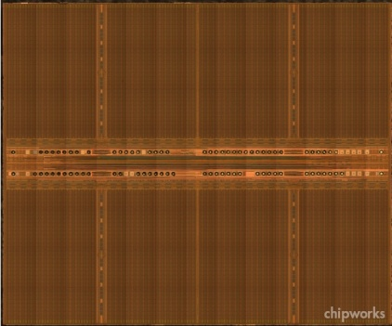
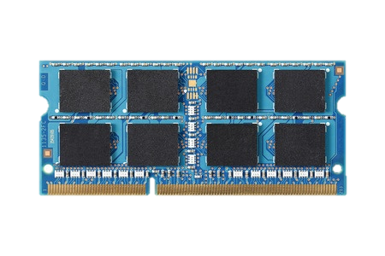
DRAM Organization
mat
processor
peripheral logic
bank
main memory
high latency
Notes:
Right figure shows the picture of real DRAM chip,
which consists of multiple banks and peripheral logic for accessing cells in banks.
Each bank is subdivided into multiple mats.

Slide 21
DRAM Cell Array: Mat
mat
bitline
mat
cell
peripheral logic
cell
wordline driver
wordline
sense amplifier
Notes:
A mat consists of 2d cell array.
The cells are horizontally connected to wordline driver by wordline,
and vertically connected to a sense amplifier by bitline.

Slide 22
Memory Element (Cell)
Component that can be in at least two states
0
1
Can be electrical, magnetic, mechanical, etc.
DRAM → Capacitor

Slide 23
Capacitor – Bucket of Electric Charge
“Charged”
“Discharged”
V_{max}
Voltage level indicator. Not part of the actual circuit
0
0
0
Charge

Slide 24
DRAM Chip
DRAM Chip
Contains billions of capacitors (also called cells)
?
0

Slide 25
Divide and Conquer
DRAM Bank
?
Challenges
Weak
Reading destroys state

Slide 26
Sense-Amplifier
V_{max}
V_{x}+δ
V_{x}
V_{x}+δ
V_{x}
Amplify the difference
V_{x} > V_{y}
Stable state
V_{y}
0
V_{y}-δ
V_{y}

Slide 27
Outline
What is DRAM?
DRAM Internal Organization
DRAM Cell
DRAM Array
DRAM Bank
Problems and Solutions
Latency (Tiered-Latency DRAM, HPCA 2013)
Parallelism (Subarray-level Parallelism, ISCA 2012)

Slide 28
DRAM Cell Read Operation
V_{max}
V_{max}
V_{max}/2 + δ
V_{max}/2
V_{max}/2 + δ
DRAM
Cell
0
Amplify the difference
Restore Cell Data
Cell loses charge
Access data
2
Sense-Amplifier
1
V_{max}/2
0

Slide 29
DRAM Cell Read Operation
Control Signal
Address
DRAM
Cell
DRAM
Cell
0
Sense-Amplifier

Slide 30
Outline
What is DRAM?
DRAM Internal Organization
DRAM Cell
DRAM Array
DRAM Bank
Problems and Solutions
Latency (Tiered-Latency DRAM, HPCA 2013; Adaptive-Latency DRAM, HPCA 2015)
Parallelism (Subarray-level Parallelism, ISCA 2012)

Slide 31
Problem
Control Signal
Address
DRAM
Cell
Much larger than a cell
Sense-Amplifier

Slide 32
Cost Amortization
Bitline
Wordline

Slide 33
DRAM Array Operation
n
Restore
Sense-Amplifier
Wordline Disable
Sensing & Amplification
Charge Restoration
Row Decoder
Charge Sharing
Wordline Enable
m
m
1
?
0
?
0
?
1
?
1
?
0
?
1
1
?
0
?
0
?
1
?
0
?
1
Row Address
?
½
↑½
1
½
½↓
0
½
½↓
0
½
↑½
1
½
↑½
1
½
½↓
0
½
↑½
1
½
½↓
0
½
½↓
0
½
↑½
1
½
½↓
0
½
↑½
1
Sense-Amplifiers
Access Data (column n)

Slide 34
Outline
What is DRAM?
DRAM Internal Organization
DRAM Cell
DRAM Array
DRAM Bank
Problems and Solutions
Latency (Tiered-Latency DRAM, HPCA 2013 Adaptive-Latency DRAM, HPCA 2015)
Parallelism (Subarray-level Parallelism, ISCA 2012)

Slide 35
DRAM Bank
How to build a DRAM bank from a DRAM array?

Slide 36
DRAM Bank: Single DRAM Array?
Long bitline
Difficult to sense data in far away cells
Row Decoder
1
0
0
1
1
0
0
1
Row Address
10000+ rows

Slide 37
DRAM Bank: Collection of Arrays
Row Decoder
1
0
0
1
1
0
0
1
Subarray
Row Decoder
Data
Row Address
Column Read/Write

Slide 38
DRAM Operation: Summary
Row Decoder
1
0
0
1
1
0
0
1
Row Decoder
Row m, Col n
1. Enable row m
2. Access col n
3. Close row
m
Row Address
Column Read/Write
m
n

Slide 39
DRAM Chip Hierarchy
Collection of Banks
Row Decoder
1
0
0
1
1
0
0
1
Row Decoder
Row Address
Column Read/Write
Collection of Subarrays

Slide 40
Outline
What is DRAM?
DRAM Internal Organization
Problems and Solutions
Latency (Tiered-Latency DRAM, HPCA 2013; Adaptive-Latency DRAM, HPCA 2015)
Parallelism (Subarray-level Parallelism, ISCA 2012)

Slide 41
Factors That Affect Performance
Latency
How fast can DRAM serve a request?
Parallelism
How many requests can DRAM serve in parallel?

Slide 42
DRAM Chip Hierarchy
Collection of Banks
Row Decoder
Parallelism
1
0
0
1
1
0
0
1
Row Decoder
Latency
Row Address
Column Read/Write
Collection of Subarrays

Slide 43
Outline
What is DRAM?
DRAM Internal Organization
Problems and Solutions
Latency (Tiered-Latency DRAM, HPCA 2013; Adaptive-Latency DRAM, HPCA 2015)
Parallelism (Subarray-level Parallelism, ISCA 2012)

Slide 44
Subarray Size: Rows/Subarray
Number of rows in subarray
Latency
Chip Area

Slide 45
Subarray Size vs. Access Latency
Shorter Bitlines => Faster access
Smaller subarrays => lower access latency

Slide 46
Subarray Size vs. Chip Area
Large Subarray
Smaller Subarrays
Area
Cost
Smaller subarrays => larger chip area

Slide 47
Chip Area vs. Access Latency
32 rows/subarray
Commodity DRAM
(512 rows/subarray)
Why is DRAM so slow?

Slide 48
Chip Area vs. Access Latency
32 rows/subarray
Commodity DRAM
(512 rows/subarray)
?
How to enable low latency without high area overhead?

Slide 49
New Proposal
Low area cost
Large Subarray
Our Proposal
Small Subarray

Slide 50
Tiered-Latency DRAM
- Higher access latency
- Higher energy/access
Far Segment
Near Segment
+ Lower access latency
+ Lower energy/access
Map frequently accessed data to near segment

Slide 51
Results Summary
Commodity DRAM
Tiered-Latency DRAM
12%
23%

Slide 52
Tiered-Latency DRAM: A Low Latency and Low Cost DRAM Architecture
Donghyuk Lee, Yoongu Kim, Vivek Seshadri, Jamie Liu, Lavanya Subramanian, Onur Mutlu
Published in the proceedings of 19th IEEE International Symposium on
High Performance Computer Architecture 2013

Slide 53
DRAM Stores Data as Charge
DRAM cell
Three steps of charge movement
1. Sensing
2. Restore
3. Precharge
Sense amplifier
Notes:
The right figure shows DRAM organization which is consists of DRAM cells and sense-amplifiers.
There are three steps for accessing DRAM.
First, when DRAM selects one of rows in its cell array, the selected cells drive their charge to sense-amplifiers.
Then, sense-amplifiers detect the charge, recognizing data of cells.
We call this operation as sensing.
Second, after sensing data from DRAM cells, sense-amplifiers drive charge to the cells for reconstructing original data.
We call this operation as restore.
Third, after restoring the cell data, DRAM deselects the accessed row and puts the sense-amplifiers to original state for next access.
We call this operation as precharge.
As shown in these three steps, DRAM operation is charge movement between cell and sense-amplifier.

Slide 54
DRAM Charge over Time
cell
cell
Data 1
charge
Sense amplifier
Sense amplifier
Data 0
Timing Parameters
Sensing
Restore
time
In theory
margin
In practice
Why does DRAM need the extra timing margin?
Notes:
Timing parameters exist to ensure sufficient movement of charge.
The figure shows the timeline for accessing DRAM in X-axis and Y-axis shows the charge amount in DRAM cell and sense-amplifier.
When selecting a row of cells, each cell drives their charge toward to the corresponding sense-amplifier.
If driven charge is more than enough to detect the data, the sense-amplifier starts to restore data by driving charge toward the cell.
This restore operation finishes when the cell is fully charged.
Ideally, DRAM timing parameters are just enough for the sufficient movement of charge.
However, in practice, there are large margin in DRAM timing parameters.
Why are these margin required?

Slide 55
Two Reasons for Timing Margin
1. Process Variation
DRAM cells are not equal
Leads to extra timing margin for cell that can store small amount of charge
1. Process Variation
DRAM cells are not equal
Leads to extra timing margin for cells that can store large amount of charge
1. Process Variation
DRAM cells are not equal
Leads to extra timing margin for cell that can store small amount of charge;
2. Temperature Dependence
DRAM leaks more charge at higher temperature
Leads to extra timing margin when operating at low temperature
Notes:
There are two reasons for the margin in DRAM timing parameters.
First is process variation and second is temperature dependence.
Let me introduce the first factor, process variation.

Slide 56
DRAM Cells are Not Equal
Ideal
Real
Smallest cell
Largest cell
Same size →
Different size →
Large variation in cell size →
Same charge →
Different charge →
Large variation in charge →
Same latency
Different latency
Large variation in access latency
Notes:
Ideally, DRAM would have uniform cells which have same size, thereby having same access latency.
Unfortunately, due to process variation, each cell has different size, thereby having different access latency.
Therefore, DRAM shows large variation in both charge amount in its cell and access latency to its cell.

Slide 57
Two Reasons for Timing Margin
1. Process Variation
DRAM cells are not equal
Leads to extra timing margin for cells that can store large amount of charge
2. Temperature Dependence
DRAM leaks more charge at higher temperature
Leads to extra timing margin when operating at low temperature
2. Temperature Dependence
DRAM leaks more charge at higher temperature
Leads to extra timing margin when operating at low temperature
2. Temperature Dependence
DRAM leaks more charge at higher temperature
Leads to extra timing margin when operating at low temperature
Notes:
There are two reasons for the margin in DRAM timing parameters.
First is process variation and second is temperature dependence.
Let me introduce the first factor, process variation.

Slide 58

Charge Leakage $∝$ Temperature
Room Temp.
Hot Temp. (85°C)
Cells store small charge at high temperature
and large charge at low temperature
→ Large variation in access latency
Small leakage
Large leakage
Notes:
DRAM leakage increases the variation.
DRAM loses their charge over time and loses more charge at higher temperature.
Therefore, DRAM cell has smallest charge when operating at hot temperature, for example 85C which is the highest temperature guaranteed by DRAM standard.
This temperature dependence increases the variation in DRAM cell charge.

Slide 59
DRAM Timing Parameters
DRAM timing parameters are dictated by the worst case
The smallest cell with the smallest charge in all DRAM products
Operating at the highest temperature
Large timing margin for the common case
Can lower latency for the common case

Slide 60
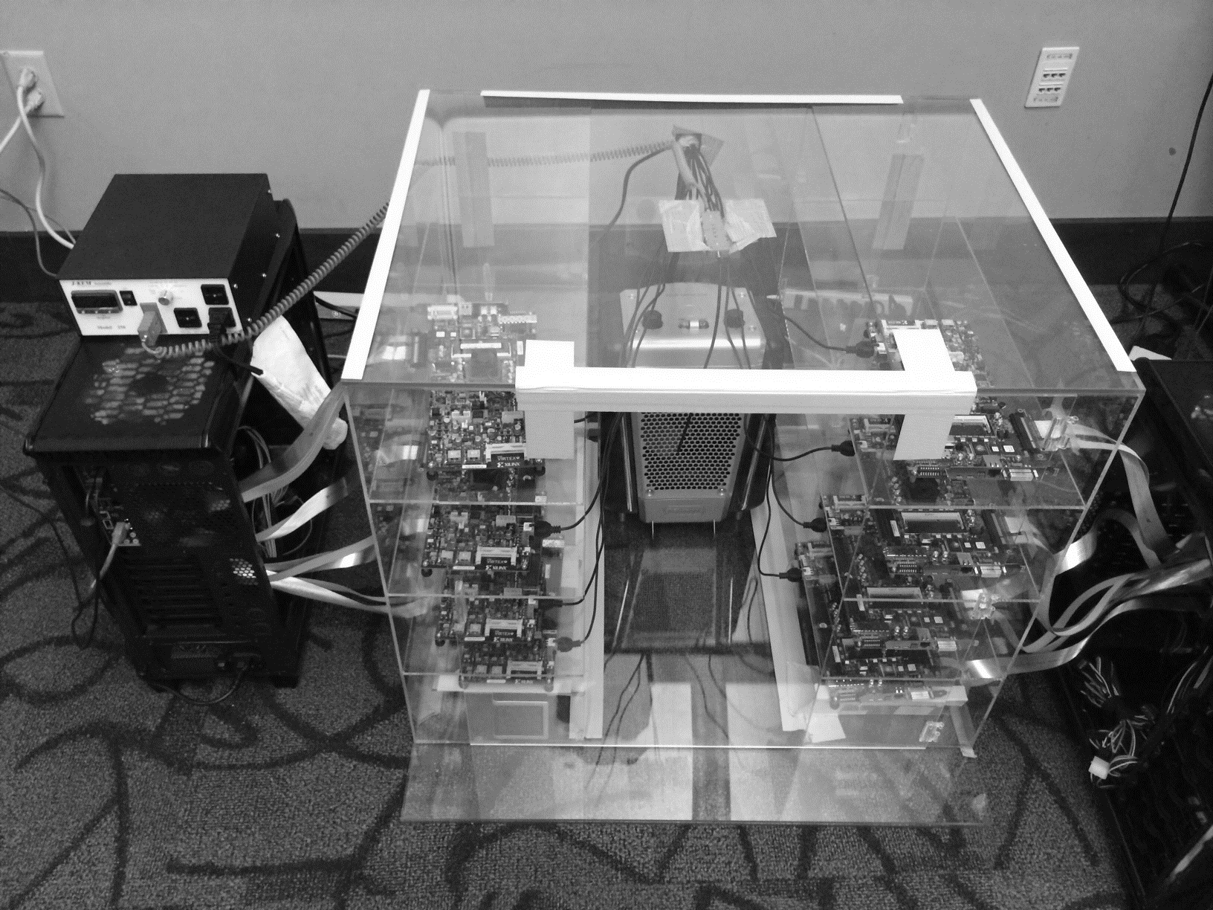
DRAM Testing Infrastructure
Temperature
Controller
FPGAs
Heater
FPGAs
PC
Notes:
This is the photo of our infrastructure, that we built mostly from scratch.
For higher throughput, we employ eight FPGAs, all of which are enclosed in thermally-regulated environment.

Slide 61
Obs 1. Faster Sensing
Timing
(tRCD)
17% ↓
No Errors
Typical DIMM at
Low Temperature
115 DIMM
characterization
More charge
Strong charge
flow
Faster sensing
Typical DIMM at Low Temperature
→ More charge → Faster sensing
Notes:
First step in DRAM operation is sensing.
In typical case, there are more charge in DRAM cell compared to the worst case.
The excessive charge enables stronger charge drive to sense-amplifier.
Then, sense-amplifier can detect data of DRAM cell fast, thereby complete sensing operation fast.
In our DRAM latency profiling results of 115 DRAM modules,
we observe that 17% potential reduction for the corresponding timing parameters of sensing.
As a result, more charge in typical cases lead to fast sensing.

Slide 62
Obs 2. Reducing Restore Time
115 DIMM
characterization
Typical DIMM at
Low Temperature
Read (tRAS)
37% ↓
Write (tWR)
54% ↓
No Errors
Larger cell &
Less leakage ➔
Extra charge
No need to fully
restore charge
Typical DIMM at lower temperature
→ More charge → Restore time reduction
Notes:
Second step in DRAM operation is restore.
Due to larger size and less leakage, typical DRAM cells have more charge than the worst cell.
Even though typical DRAM does not restore the excessive charge during restore operation,
eventually the typical cell has more charge than the worst case cell, guaranteeing reliable operations.
By reducing this restore time in DRAM read/write, our DRAM latency characterization shows significant potential to reduce corresponding timing parameters. For example, 37% for read and 54% for write.
As a result, more charge in typical cases enables restore time reduction.

Slide 63
Obs 3. Reducing Precharge Time
Typical DIMM at
Low Temperature
Sensing
Half
Precharge
Empty (0V)
Full (Vdd)
Bitline
Sense amplifier
Precharge ?
– Setting bitline to half-full charge
Notes:
Third step is precharge. Previously we explained the precharge simply as going back to original state.
Let me introduce more details about precharge.
To detect data in DRAM cell, DRAM has sense-amplifier and wire connection to the bitline.
DRAM preserve their a bit of data in two charge state, empty and fully charged.
During sensing and restore, the bitline moves to either of these two states.
After finishing the access, the bitline should be go back to the half of these two state.
We call this precharge. Unfortunately, bitline is usually long by connecting hundred of cells such that it takes long time for precharge.

Slide 64
Obs 3. Reducing Precharge Time
Access full cell
Access empty cell
Timing
(tRP)
35% ↓
No Errors
115 DIMM
characterization
Not fully precharged
More charge
→ strong sensing
Half
Empty (0V)
Full (Vdd)
bitline
Typical DIMM at Lower Temperature
→ More charge → Precharge time reduction
Notes:
Let us observe the impact of reducing precharge with a simple example.
The sense-amplifier first accesses an empty cell then not fully precharged by reducing corresponding timing parameter.
Then DRAM next access a fully charged cell.
Due to the bias in the bitline, it takes longer time to access the fully charged cell.
However, if the cell has much excessive charge, the strong charge flow overcomes the bias in the bitline, leading to reliable access.
Our DRAM latency evaluation shows that in typical case, we can reduce corresponding timing parameter by 35% without errors.
Therefore, more charge in typical cases enables precharge time reduction.

Slide 65
Adaptive-Latency DRAM
Key idea
Optimize DRAM timing parameters online
Two components
DRAM manufacturer profiles multiple sets of
reliable DRAM timing parameters at different temperatures for each DIMM
System monitors DRAM temperature & uses appropriate DRAM timing parameters
reliable DRAM timing parameters
DRAM temperature

Slide 66
Real System Evaluation
Average
Improvement
14.0%
10.4%
Performance Improvement
2.9%
all-35-workload
AL-DRAM provides high performance improvement, greater for multi-core workloads

Slide 67
Summary: AL-DRAM
Observation
DRAM timing parameters are dictated by the worst-case cell (smallest cell at highest temperature)
Our Approach: Adaptive-Latency DRAM (AL-DRAM)
Optimizes DRAM timing parameters for the common case (typical DIMM operating at low temperatures)
Analysis: Characterization of 115 DIMMs
Great potential to lower DRAM timing parameters (17 – 54%) without any errors
Real System Performance Evaluation
Significant performance improvement (14% for memory-intensive workloads) without errors (33 days)
Notes:
Let me summarize.
DRAM timing parameters are dictated by the worst case cell.
We propose Adaptive-Latency DRAM that optimizes DRAM timing parameters for common cases
Our characterization shows the significant potential to lower DRAM timing parameters.
Our real system evaluation shows that our mechanism provides significant performance improvement without introducing errors.

Slide 68
Adaptive-Latency DRAM: Optimizing DRAM Timing for the Common-Case
Donghyuk Lee, Yoongu Kim,
Gennady Pekhimenko, Samira Khan, Vivek Seshadri, Kevin Chang, and Onur Mutlu
Published in the proceedings of 21st
International Symposium on High Performance Computer Architecture 2015

Slide 69
Outline
What is DRAM?
DRAM Internal Organization
Problems and Solutions
Latency (Tiered-Latency DRAM, HPCA 2013;
Adaptive-Latency DRAM, HPCA 2015)
Parallelism (Subarray-level Parallelism, ISCA 2012)

Slide 70
Parallelism: Demand vs. Supply
Demand
Supply
Out-of-order Execution
Multi-cores
Multiple
Banks
Prefetchers

Slide 71
Increasing Number of Banks?
Adding more banks → Replication of shared structures
Replication → Cost
How to improve available parallelism within DRAM?

Slide 72
Our Observation
Local to a subarray
1. Wordline enable
4. Charge restoration
2. Charge sharing
5. Wordline disable
3. Sense amplify
6. Restore sense-amps
Data Access
Time

Slide 73
Subarray-Level Parallelism
Row Decoder
Row Address
1
0
0
1
1
0
0
1
Time share
Replicate
Row Decoder
Row Address
Row Address
Column Read/Write

Slide 74
Subarray-Level Parallelism: Benefits
Two requests to different subarrays in same bank
Commodity DRAM
Data Access
Data Access
Time
Data Access
Data Access
Saved Time
Subarray-Level Parallelism

Slide 75
Results Summary
Commodity DRAM
Subarray-Level Parallelism
17%
19%

Slide 76
A Case for Exploiting Subarray-Level Parallelism (SALP) in DRAM
Yoongu Kim, Vivek Seshadri, Donghyuk Lee, Jamie Liu, Onur Mutlu
Published in the proceedings of 39th
International Symposium on Computer Architecture 2012

Slide 77
Review #4
RowClone: Fast and Energy-Efficient In-DRAM Bulk Data Copy and Initialization Vivek Seshadri et al., MICRO 2013

Slide 78
CSC 2224: Parallel Computer Architecture and Programming Main Memory Fundamentals
Prof. Gennady Pekhimenko
University of Toronto
Fall 2019
The content of this lecture is adapted from the slides of
Vivek Seshadri, Donghyuk Lee, Yoongu Kim,
and lectures of Onur Mutlu @ ETH and CMU

